Slide 1
Announcements
Homework 8 is out
Due Monday 4/7 at 11:59pm
Final Contest (Optional)
On-going!

Slide 2
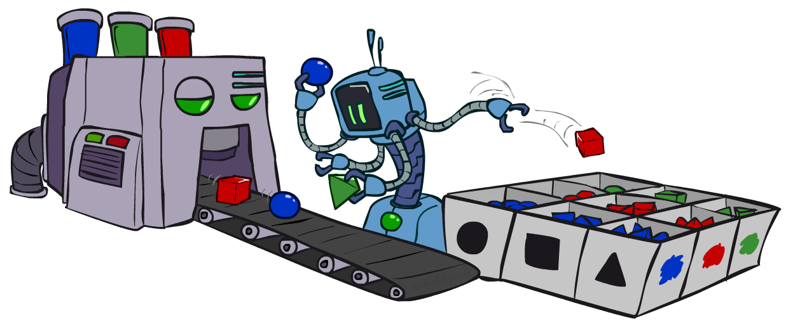
CS 188: Artificial Intelligence
Bayes’ Nets: Sampling
Instructors: Dan Klein and Pieter Abbeel --- University of California, Berkeley
[These slides were created by Dan Klein and Pieter Abbeel for CS188 Intro to AI at UC Berkeley. All CS188 materials are available at http://ai.berkeley.edu.]
Notes:
Please retain proper attribution, including the reference to ai.berkeley.edu. Thanks!

Slide 3
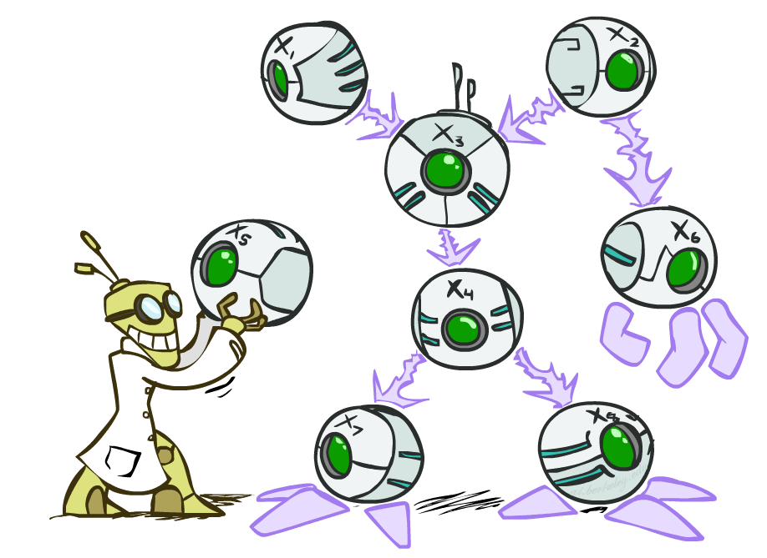

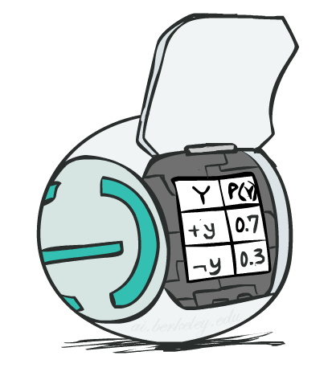
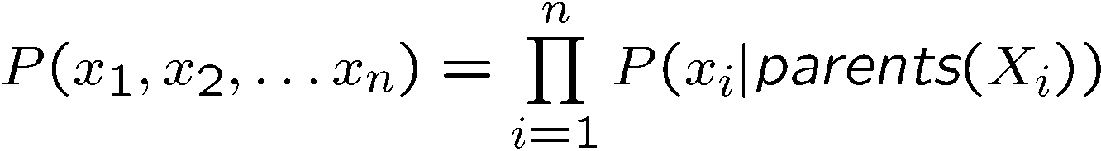
Bayes’ Net Representation
A directed, acyclic graph, one node per random variable
A conditional probability table (CPT) for each node
A collection of distributions over X, one for each combination of parents’ values
Bayes’ nets implicitly encode joint distributions
As a product of local conditional distributions
To see what probability a BN gives to a full assignment, multiply all the relevant conditionals together:

Slide 4
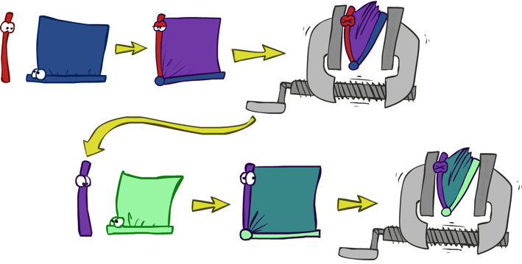


























Variable Elimination
Interleave joining and marginalizing
d^{k} entries computed for a factor over k variables with domain sizes d
Ordering of elimination of hidden variables can affect size of factors generated
Worst case: running time exponential in the size of the Bayes’ net
…
…

Slide 5
Worst Case Complexity?
CSP:
If we can answer P(z) equal to zero or not, we answered whether the 3-SAT problem has a solution.
Hence inference in Bayes’ nets is NP-hard. No known efficient probabilistic inference in general.
…
…

Slide 6

Approximate Inference: Sampling

Slide 7

Sampling
Sampling is a lot like repeated simulation
Predicting the weather, basketball games, …
Basic idea
Draw N samples from a sampling distribution S
Compute an approximate posterior probability
Show this converges to the true probability P
Why sample?
Learning: get samples from a distribution you don’t know
Inference: getting a sample is faster than computing the right answer (e.g. with variable elimination)

Slide 8
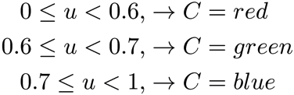

Sampling
Sampling from given distribution
Step 1: Get sample u from uniform distribution over [0, 1)
E.g. random() in python
Step 2: Convert this sample u into an outcome for the given distribution by having each outcome associated with a sub-interval of [0,1) with sub-interval size equal to probability of the outcome
Example
If random() returns u = 0.83, then our sample is C = blue
E.g, after sampling 8 times:
C | P(C)
red | 0.6
green | 0.1
blue | 0.3

Slide 9
Sampling in Bayes’ Nets
Prior Sampling
Rejection Sampling
Likelihood Weighting
Gibbs Sampling

Slide 10
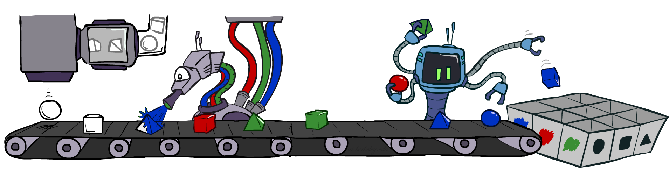
Prior Sampling

Slide 11




Prior Sampling
+c | 0.5
-c | 0.5
Cloudy
Cloudy
+c | +s | 0.1
 | -s | 0.9
-c | +s | 0.5
 | -s | 0.5
+c | +r | 0.8
 | -r | 0.2
-c | +r | 0.2
 | -r | 0.8
Sprinkler
Sprinkler
Rain
Rain
WetGrass
WetGrass
Samples:
+s | +r | +w | 0.99
 |  | -w | 0.01
 | -r | +w | 0.90
 |  | -w | 0.10
-s | +r | +w | 0.90
 |  | -w | 0.10
 | -r | +w | 0.01
 |  | -w | 0.99
+c, -s, +r, +w
-c, +s, -r, +w
…

Slide 12
Prior Sampling
For i=1, 2, …, n
Sample x_{i} from P(X_{i} | Parents(X_{i}))
Return (x₁, x₂, …, x_{n})

Slide 13
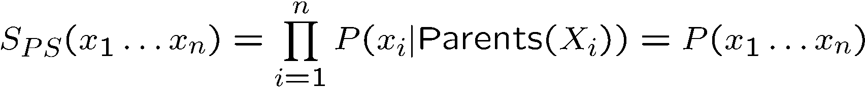

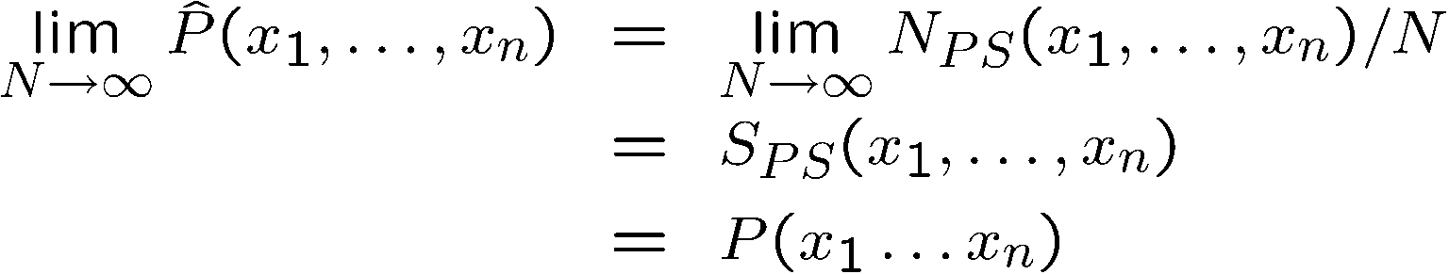
Prior Sampling
This process generates samples with probability:
…i.e. the BN’s joint probability
Let the number of samples of an event be
Then
I.e., the sampling procedure is consistent

Slide 14
Example
We’ll get a bunch of samples from the BN:
+c, -s, +r, +w
+c, +s, +r, +w
-c, +s, +r, -w
+c, -s, +r, +w
-c, -s, -r, +w
If we want to know P(W)
We have counts <+w:4, -w:1>
Normalize to get P(W) = <+w:0.8, -w:0.2>
This will get closer to the true distribution with more samples
Can estimate anything else, too
What about P(C| +w)? P(C| +r, +w)? P(C| -r, -w)?
Fast: can use fewer samples if less time (what’s the drawback?)
C
S
R
W

Slide 15
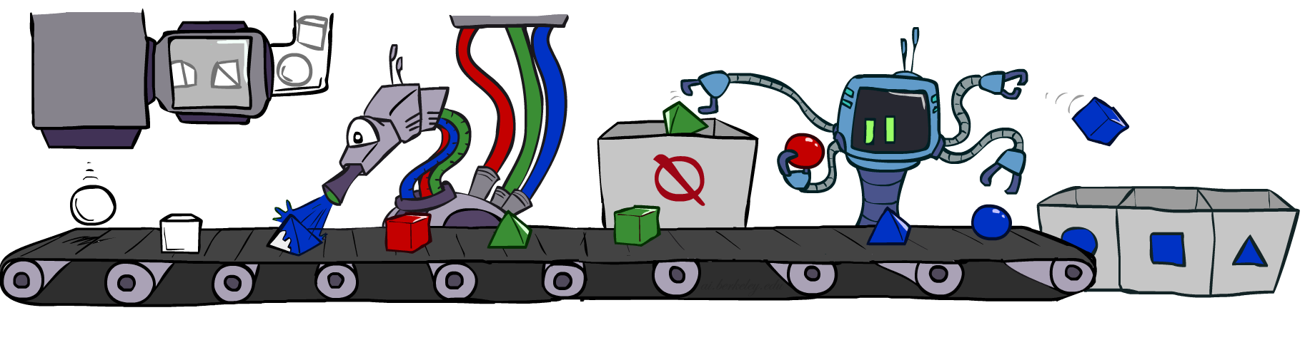
Rejection Sampling

Slide 16
Rejection Sampling
Let’s say we want P(C)
No point keeping all samples around
Just tally counts of C as we go
Let’s say we want P(C| +s)
Same thing: tally C outcomes, but ignore (reject) samples which don’t have S=+s
This is called rejection sampling
It is also consistent for conditional probabilities (i.e., correct in the limit)
C
S
R
W
+c, -s, +r, +w
+c, +s, +r, +w
-c, +s, +r, -w
+c, -s, +r, +w
-c, -s, -r, +w

Slide 17
Rejection Sampling
IN: evidence instantiation
For i=1, 2, …, n
Sample x_{i} from P(X_{i} | Parents(X_{i}))
If x_{i} not consistent with evidence
Reject: Return, and no sample is generated in this cycle
Return (x₁, x₂, …, x_{n})

Slide 18
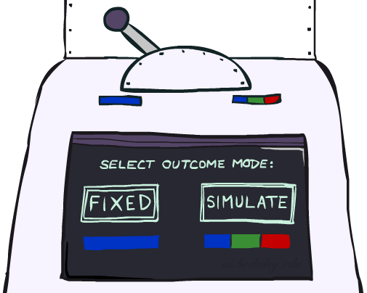
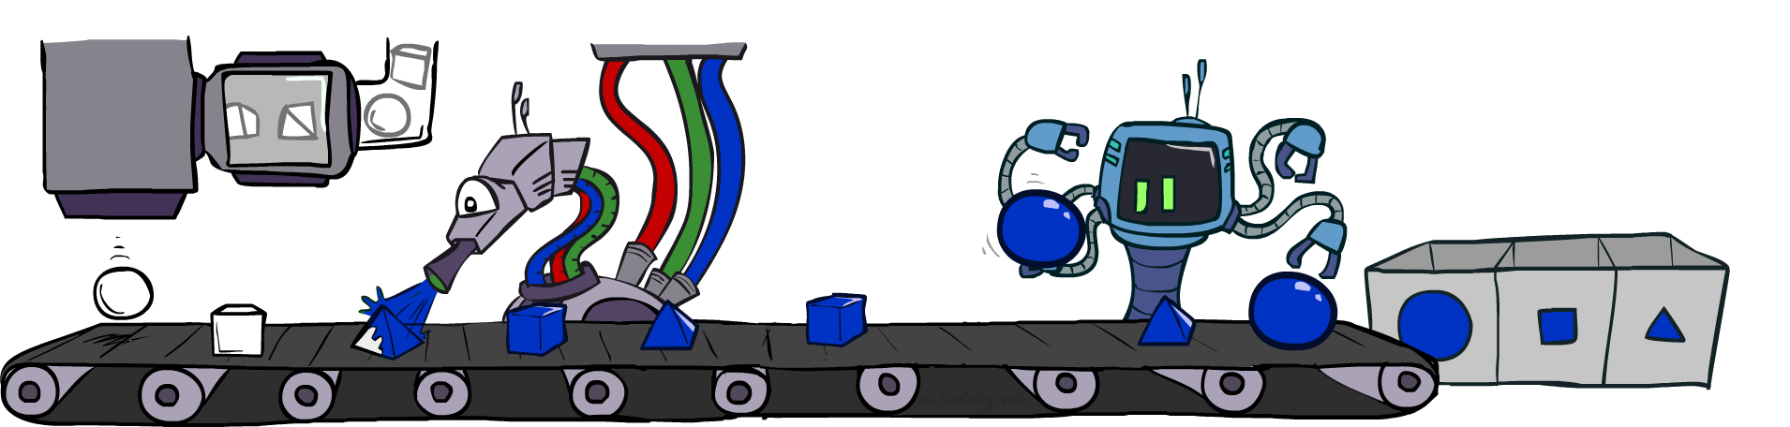
Likelihood Weighting

Slide 19
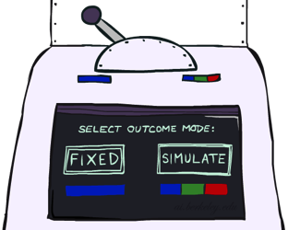


Likelihood Weighting
Problem with rejection sampling:
If evidence is unlikely, rejects lots of samples
Evidence not exploited as you sample
Consider P(Shape|blue)
Idea: fix evidence variables and sample the rest
Problem: sample distribution not consistent!
Solution: weight by probability of evidence given parents
pyramid, green
pyramid, red
sphere, blue
cube, red
sphere, green
pyramid, blue
pyramid, blue
sphere, blue
cube, blue
sphere, blue
Shape
Color
Shape
Color

Slide 20



Likelihood Weighting
+c | 0.5
-c | 0.5
Cloudy
Cloudy
+c | +s | 0.1
 | -s | 0.9
-c | +s | 0.5
 | -s | 0.5
+c | +r | 0.8
 | -r | 0.2
-c | +r | 0.2
 | -r | 0.8
Sprinkler
Sprinkler
Rain
Rain
WetGrass
Samples:
WetGrass
+s | +r | +w | 0.99
 |  | -w | 0.01
 | -r | +w | 0.90
 |  | -w | 0.10
-s | +r | +w | 0.90
 |  | -w | 0.10
 | -r | +w | 0.01
 |  | -w | 0.99
+c, +s, +r, +w
…

Slide 21
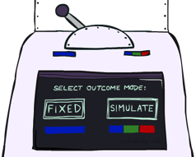
Likelihood Weighting
IN: evidence instantiation
w = 1.0
for i=1, 2, …, n
if X_{i} is an evidence variable
X_{i} = observation x_{i} for X_{i}
Set w = w * P(x_{i} | Parents(X_{i}))
else
Sample x_{i} from P(X_{i} | Parents(X_{i}))
return (x₁, x₂, …, x_{n}), w

Slide 22
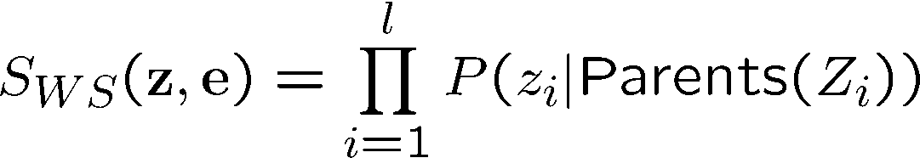
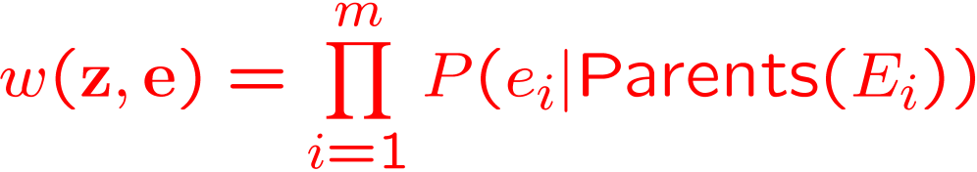
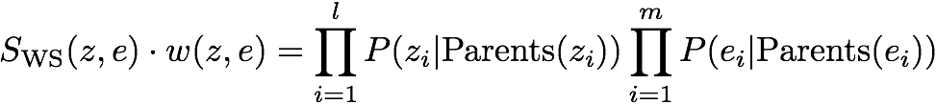

Likelihood Weighting
Sampling distribution if z sampled and e fixed evidence
Now, samples have weights
Together, weighted sampling distribution is consistent
Cloudy
C
S
R
W

Slide 23

Likelihood Weighting
Likelihood weighting is good
We have taken evidence into account as we generate the sample
E.g. here, W’s value will get picked based on the evidence values of S, R
More of our samples will reflect the state of the world suggested by the evidence
Likelihood weighting doesn’t solve all our problems
Evidence influences the choice of downstream variables, but not upstream ones (C isn’t more likely to get a value matching the evidence)
We would like to consider evidence when we sample every variable
→ Gibbs sampling

Slide 24
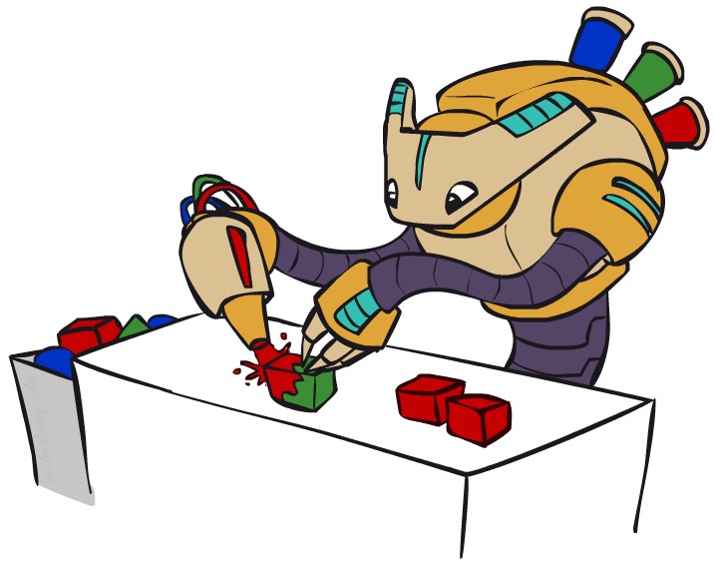
Gibbs Sampling

Slide 25
Gibbs Sampling
Procedure: keep track of a full instantiation x₁, x₂, …, x_{n}. Start with an arbitrary instantiation consistent with the evidence. Sample one variable at a time, conditioned on all the rest, but keep evidence fixed. Keep repeating this for a long time.
Property: in the limit of repeating this infinitely many times the resulting sample is coming from the correct distribution
Rationale: both upstream and downstream variables condition on evidence.
In contrast: likelihood weighting only conditions on upstream evidence, and hence weights obtained in likelihood weighting can sometimes be very small. Sum of weights over all samples is indicative of how many “effective” samples were obtained, so want high weight.

Slide 26
Gibbs Sampling Example: P( S | +r)
Step 1: Fix evidence
R = +r
Steps 3: Repeat
Choose a non-evidence variable X
Resample X from P( X | all other variables)
Step 2: Initialize other variables
Randomly
C
C
S
+r
S
+r
W
W
C
C
C
C
C
C
S
+r
S
+r
S
+r
S
+r
S
+r
S
+r
W
W
W
W
W
W

Slide 27
Gibbs Sampling
How is this better than sampling from the full joint?
In a Bayes’ Net, sampling a variable given all the other variables (e.g. P(R|S,C,W)) is usually much easier than sampling from the full joint distribution
Only requires a join on the variable to be sampled (in this case, a join on R)
The resulting factor only depends on the variable’s parents, its children, and its children’s parents (this is often referred to as its Markov blanket)

Slide 28
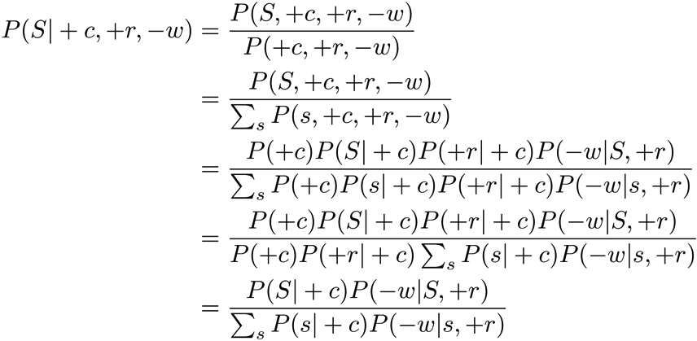
Efficient Resampling of One Variable
C
Sample from P(S | +c, +r, -w)
Many things cancel out – only CPTs with S remain!
More generally: only CPTs that have resampled variable need to be considered, and joined together
S
+r
W

Slide 29


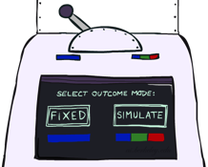
Bayes’ Net Sampling Summary
Prior Sampling P
Likelihood Weighting P( Q | e)
Rejection Sampling P( Q | e )
Gibbs Sampling P( Q | e )

Slide 30
Further Reading on Gibbs Sampling*
Gibbs sampling produces sample from the query distribution P( Q | e ) in limit of re-sampling infinitely often
Gibbs sampling is a special case of more general methods called Markov chain Monte Carlo (MCMC) methods
Metropolis-Hastings is one of the more famous MCMC methods (in fact, Gibbs sampling is a special case of Metropolis-Hastings)
You may read about Monte Carlo methods – they’re just sampling

Slide 31
How About Particle Filtering?
X₁
X₂
X₂
= likelihood weighting
E₂
Elapse
Weight
Resample
Particles:
(3,3)
(2,3)
(3,3)
(3,2)
(3,3)
(3,2)
(1,2)
(3,3)
(3,3)
(2,3)
Particles:
(3,2)
(2,3)
(3,2)
(3,1)
(3,3)
(3,2)
(1,3)
(2,3)
(3,2)
(2,2)
Particles:
(3,2) w=.9
(2,3) w=.2
(3,2) w=.9
(3,1) w=.4
(3,3) w=.4
(3,2) w=.9
(1,3) w=.1
(2,3) w=.2
(3,2) w=.9
(2,2) w=.4
(New) Particles:
(3,2)
(2,2)
(3,2)
(2,3)
(3,3)
(3,2)
(1,3)
(2,3)
(3,2)
(3,2)

Slide 32
Particle Filtering
Particle filtering operates on ensemble of samples
Performs likelihood weighting for each individual sample to elapse time and incorporate evidence
Resamples from the weighted ensemble of samples to focus computation for the next time step where most of the probability mass is estimated to be

Slide 33
Markov Chain Monte Carlo*
Idea: instead of sampling from scratch, create samples that are each like the last one.
Procedure: resample one variable at a time, conditioned on all the rest, but keep evidence fixed. E.g., for P(b|c):
Properties: Now samples are not independent (in fact they’re nearly identical), but sample averages are still consistent estimators!
What’s the point: both upstream and downstream variables condition on evidence.
+b
+a
+c
-b
+a
+c
-b
-a
+c

